Slide 1

ONLINE CLASS
GRAPH THEORY
BICTE $6^{TH}$ SEMESTER
2078/02/18
PRESENTED BY KALYAN DAHAL

Slide 2
Find the vertex, edge and regions of planar graph and verify the Eular’s formula.
Here, v = 3, e = 3, r = 2
Now, v – e + r = 3 – 3 + 2
= 2.
Hence, verified the Euler’s theorem.

Slide 3
Find the vertex, edge and regions of planar graph and verify the Euler's formula.
Here, v = 4, e = 8, r = 6
Now, v – e + r = 4 – 8 + 6
= 2.
Hence, verified the Euler’s theorem.

Slide 4
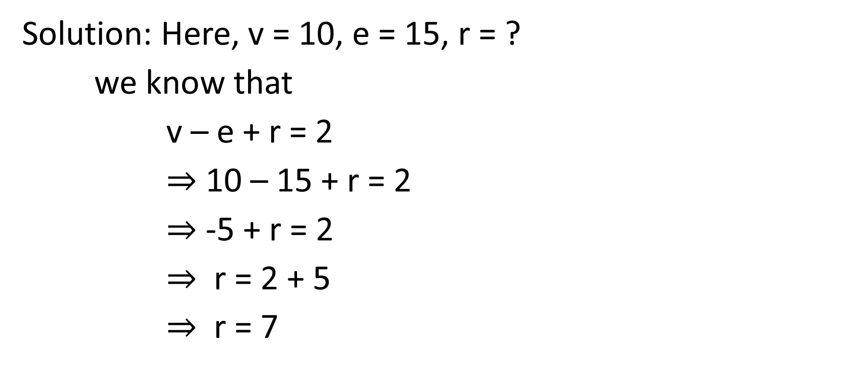
Find the regions of planar graph if vertex and edge is 10 and 15 respectively.
Solution: Here, v = 10, e = 15, r = ?
we know that
v – e + r = 2
$⇒$ 10 – 15 + r = 2
$⇒$ -5 + r = 2
$⇒$ r = 2 + 5
$⇒$ r = 7

Slide 5
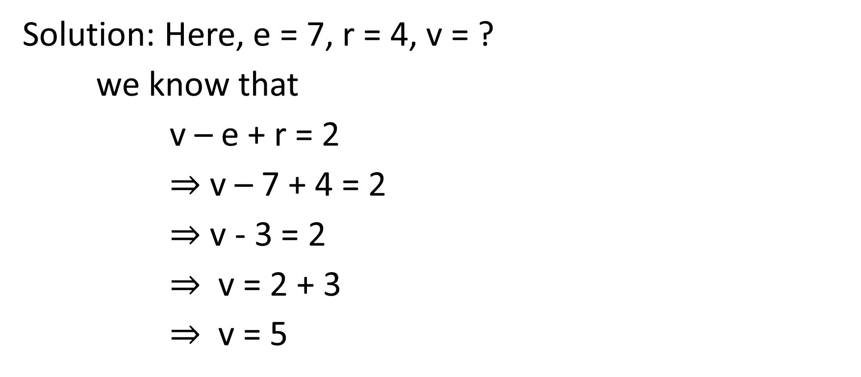
Find the vertices of planar graph if edge and region is 7 and 4 respectively.
Solution: Here, e = 7, r = 4, v = ?
we know that
v – e + r = 2
$⇒$ v – 7 + 4 = 2
$⇒$ v - 3 = 2
$⇒$ v = 2 + 3
$⇒$ v = 5

Slide 6






Find the chromatic number of the given graph.
$$v_{1}$$
$$v_{2}$$
$$v_{6}$$
$$v_{3}$$
$$v_{5}$$
$$v_{4}$$

Slide 7
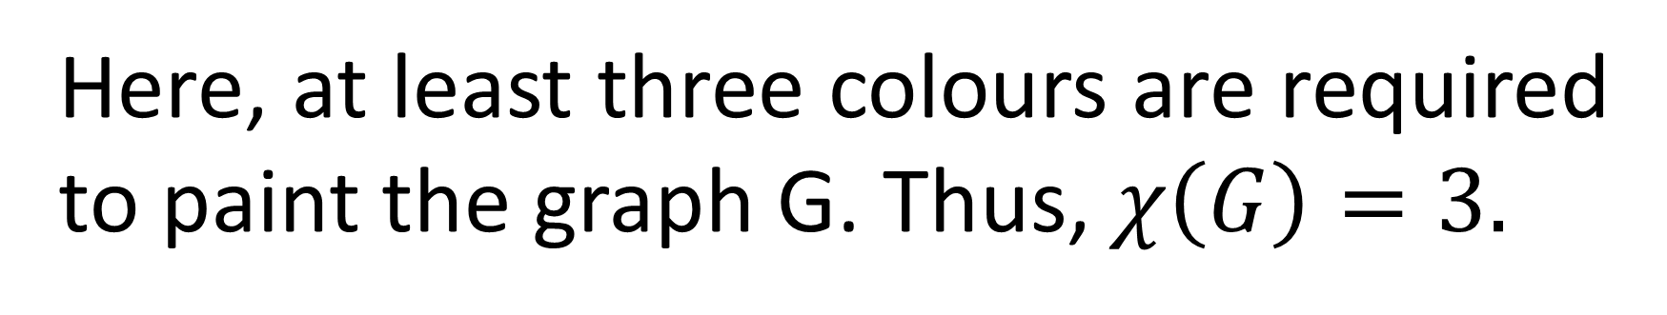
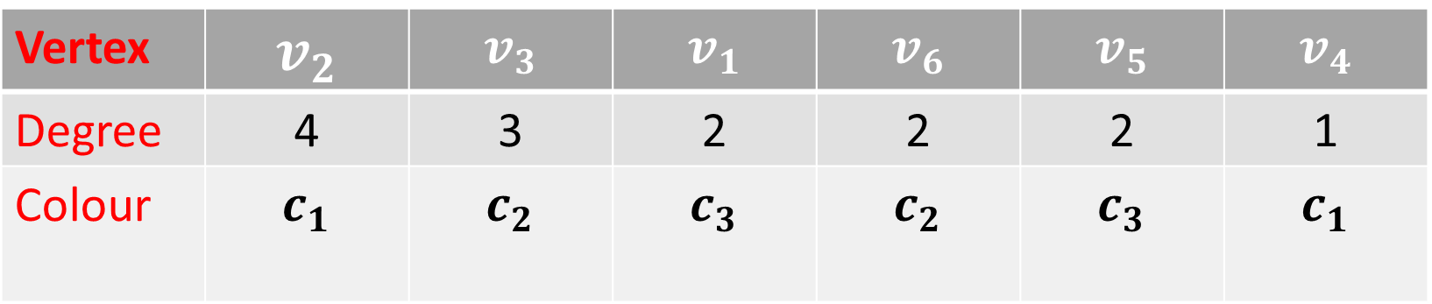
Solution: From the figure we have,
Vertex | $$v_{2}$$ | $$v_{3}$$ | $$v_{1}$$ | $$v_{6}$$ | $$v_{5}$$ | $$v_{4}$$
Degree | 4 | 3 | 2 | 2 | 2 | 1
Colour | $$c_{1}$$ | $$c_{2}$$ | $$c_{3}$$ | $$c_{2}$$ | $$c_{3}$$ | $$c_{1}$$
Here, at least three colours are required to paint the graph G. Thus, $χ\left(G\right)=3.$

Slide 8



Draw the planar multigraph having 3 vertices and 6 edges.
$$v_{1}$$
$$v_{3}$$
$$v_{2}$$

Slide 9


